Slide 1
Birds Are(n’t) Real
The Team Studying Birds

Slide 2
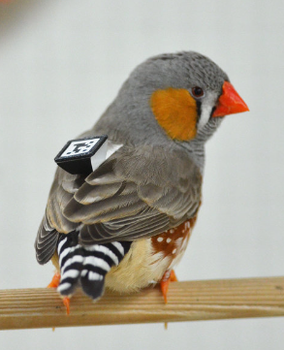
The Task
To study the effects of a bird’s personality on their spread of sickness.
Accomplished By:
Tracking QR codes attached to bird backpacks.
Using Raspberry Pis and other external hardware.

Slide 3
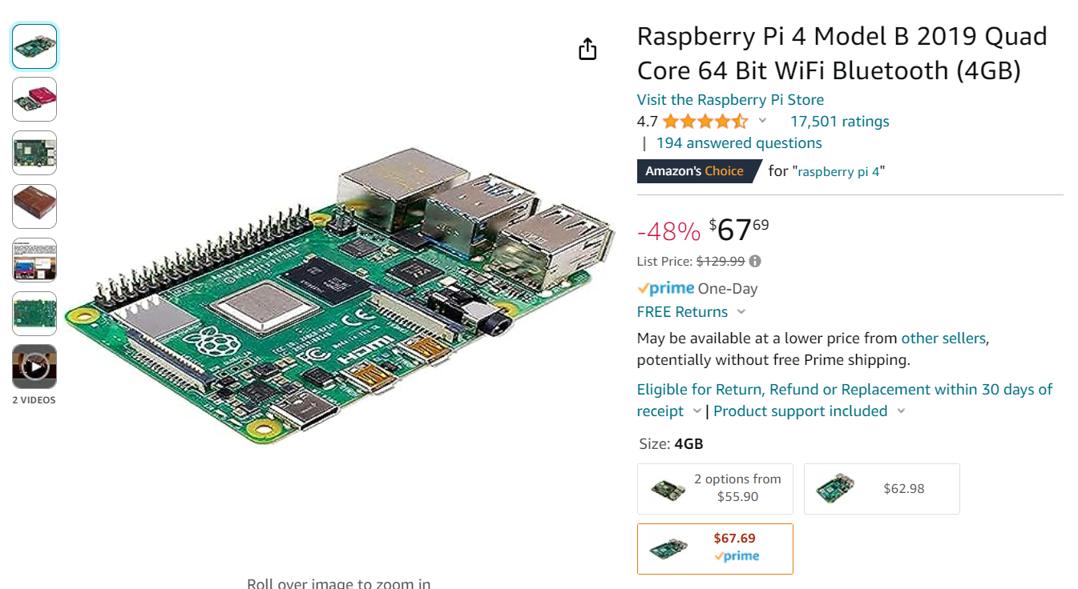

Slide 4
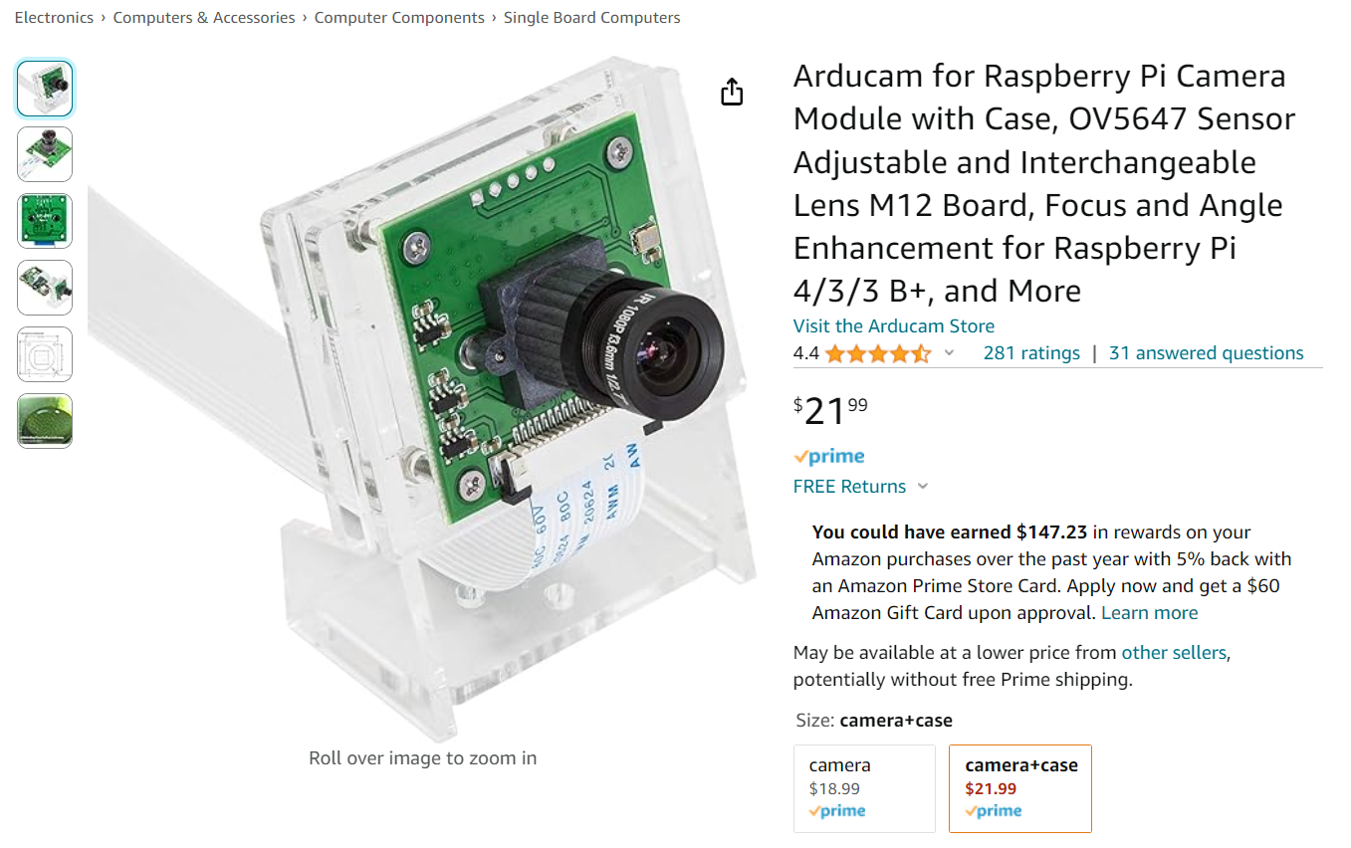

Slide 5
The Update
Setup our GitHub repository.
Finalized our team contract.
Had our first meeting with our sponsor this morning.

Slide 6
The Update
Conducted initial research on the relevant topics.
Basic Raspberry Pi information
Programming
Camera -> Raspberry Pi
Remote Connection
QR extraction and their algorithms
General Research on Finch Tracking
Looked into possible alternatives (RFID)

Slide 7
Next Sprint
Hardware will be in by Tuesday next week.
Load the Raspberry Pi with the basic necessary software.
Establish a remote connection with the Raspberry Pi.
Establish a 1:1 connection between camera and Raspberry Pi.
Scan and recognize a QR code with the camera.

